Slide 1


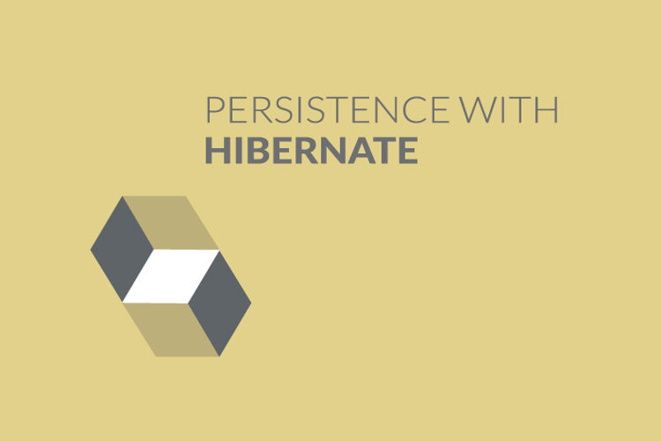
Layered Architecture
Chapter 10

Slide 2
Today’s Agenda
Layered Architecture
Problems With Our Current Approach
Introduction To Layered Architecture
The Three Layers Involved
Introduction To DAO PAttern
Example

Slide 3
Problem With Our Previous Approach
Although our previous code worked and performed all CRUD operations but it has a messy codebase.
In our current approach it will take time to figure out where particular features are located.
It may become a real challenge to unit test, debug, or add new functionality.

Slide 4
The Solution
For removing these drawbacks there is an industry recommended smart solution called three-tier (or three-layer) architecture.
The 3-layer architecture provides programmers with a chance to extend, modularize, and configure their applications perfectly.

Slide 5
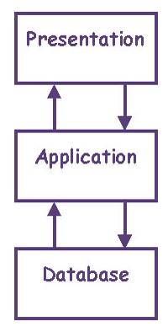
What Do The 3 Tiers Mean ?
A 3-tier architecture includes three parts (tiers or layers) of logical computing and these layers are :
Presentation layer
Business/Application layer
Data Access layer

Slide 6
Layer 1: Presentation Layer
The presentation tier represents the front-end layer in the three-tier system.
It involves the User Interface that is often graphical and accessible via a browser or a window-based application.

Slide 7
Layer 1: Presentation Layer
It contains useful content for end-users.
This layer is often built using GUI frameworks like Swing or JavaFx for a desktop application or using HTML5, JS, CSS for a web application
Nowadays it is popularly built using web development frameworks, such as Angular, React, Ember and others, can also be used here.

Slide 8
Layer 2: Business/ Application Layer
The application tier contains the functional business logic which drives an application’s core capabilities.
It defines what data is required and behaves as a client in relation to the 3rd tier of application.
It’s often written in Java, C#, Python, C++, etc.

Slide 9
Layer 3: Data Access Layer
The data tier comprises of the database/data storage system and data access layer.
The data access layer runs the query and returns results to the business layer which forwards it to the presentation layer.

Slide 10
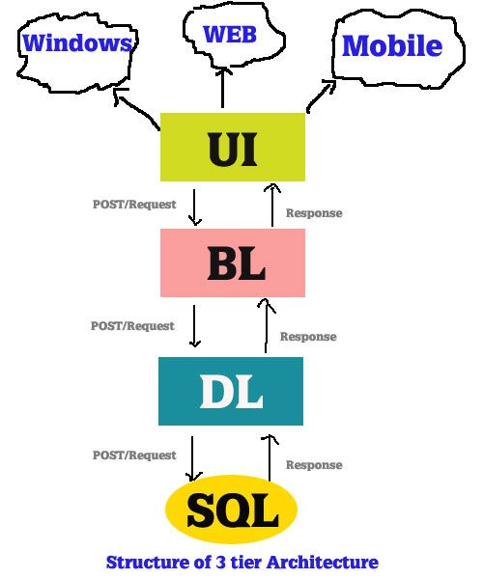
All Three Layers

Slide 11
An Example
Suppose you are seeking movie shows’ times in your geographic area with the help of a web application.
The presentation system shows a web page with some fields you have to enter. For example, your pin code and the date you want to view a show.
Then this info is moved to the Business logic layer that models a query and conveys it to the Database tier.
The Database layer runs the query and returns results (a list of shows available in your area) to the Business layer, which formats it into a web page. Then the page is sent back to the browser. The first tier displays it on your device. And that’s it.

Slide 12
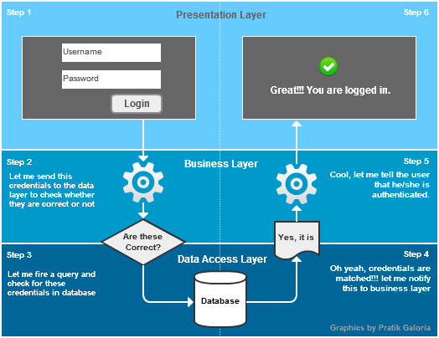
Diagrammatic View

Slide 13
Benefits
It gives you the ability to update the technology stack of one tier, without impacting other areas of the application.
It allows for different development teams to each work on their own areas of expertise.

Slide 14
Benefits
It provides an ease of maintenance of the code base, managing presentation code and business logic separately, so that a change to business logic, for example, does not impact the presentation layer.

Slide 15
Introducing DAO Pattern
DAO stands for Data Access Object.
DAO Design Pattern is used to separate the data persistence logic in a separate layer.
This way, the service remains completely unaware about how the low-level operations to access the database is done.
This is known as the principle of Separation of Logic.

Slide 16
Components In DAO Pattern
With DAO design pattern, we have following components on which our design depends:
The model which is transferred from one layer to the other.
The interfaces which provides a flexible design.
The interface implementation which is a concrete implementation of the persistence logic.

Slide 17
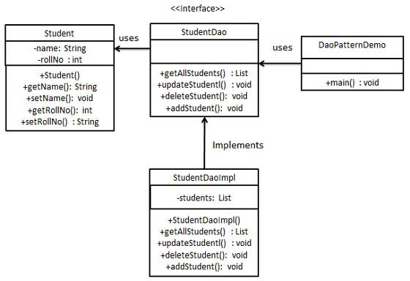
Diagrammatic View

Slide 18
Explanation
In the previous demo , we have a Student object acting as a Model or DTO (Data Transfer Object) or Value Object
StudentDao is Data Access Object Interface.
StudentDaoImpl is concrete class implementing Data Access Object Interface.
DaoPatternDemo, is the client application or main class which will use StudentDao to interact with database

Slide 19
Benefits Of DAO
While changing a persistence mechanism, service layer doesn’t even have to know where the data comes from.
For example, if we’re thinking of shifting from using Oracle to MongoDB, all changes are needed to be done in the DAO layer only.

Slide 20
Benefits Of DAO
DAO pattern emphasis on the loose coupling between different components of an application.
So, the View layer has no dependency on DAO layer and only Service layer depends on it, even that with the interfaces and not from concrete implementation..

Slide 21
Benefits Of DAO
As the persistence logic is completely separate, it is much easier to write Unit tests for individual components.
For example, if we’re using JUnit for testing frameworks, it will be easy to mock the individual components of our application.

Slide 22
Benefits Of DAO
As we work with interfaces in DAO pattern, it also emphasizes the style of “work with interfaces instead of implementation” which is an excellent OOPs style of programming.

